Slide 1
Summary of our course so far
Introduction to databases
Relational Algebra
Basic SQL commands (select, insert,delete,inner join, set operations)
Advanced SQL commands (stored procedures, views, aggregate functions with group by)
How to design a database ( 0 NF, 1NF, 2NF,3NF)
Secondary Storage file structures, B+ Trees
Indexing
Transactions

Slide 2
Summary of our course so far
Introduction to databases
Relational Algebra
Basic SQL commands (select, insert,delete,inner join, set operations)
Advanced SQL commands (stored procedures, views, aggregate functions with group by)
How to design a database ( 0 NF, 1NF, 2NF,3NF)
Secondary Storage file structures, B+ Trees
Indexing
Transactions

Slide 3
B Trees
B-tree: Multiway search tree, used for efficient data storage and retrieval.
B+ tree: A type of B-tree where data records are in leaf nodes, enabling faster sequential access.
Importance:
Optimizes disk access.
Used in database indexing and large file systems
Ideal for range queries and large sequential access data.
The "B" in B-tree does not stand for binary but is thought to derive from "Bayer” founder of the algorithm or “Balanced”

Slide 4
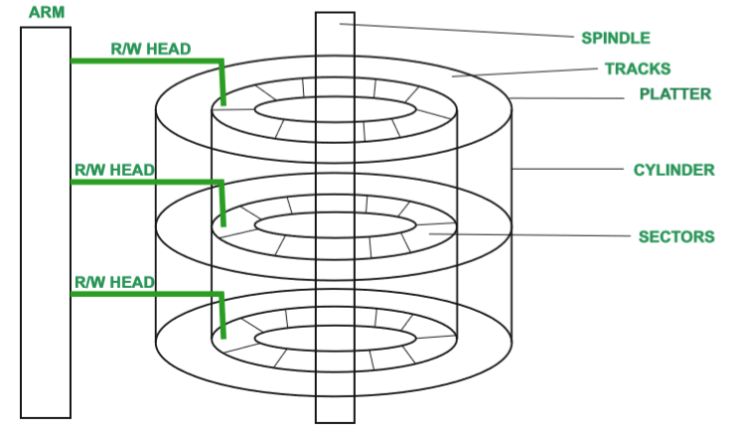

Slide 5
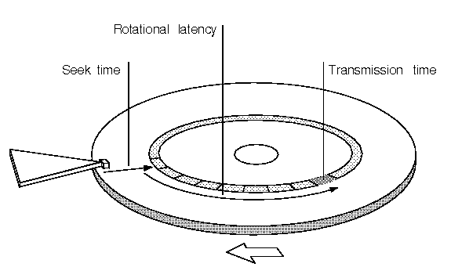
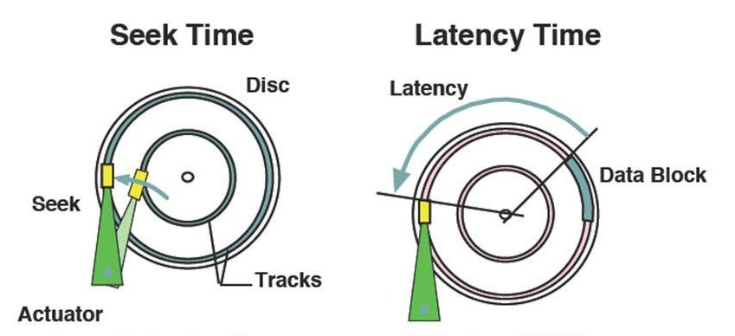
What is Seek Time? Rotational Latency? Transmission Time?

Slide 6
Formal definition of B+ Tree Properties
Properties of a B+ Tree of order v :
All internal nodes (except root) has at least v keys and at most 2v keys .
The root has at least 2 children unless it’s a leaf..
All leaves are on the same level.
An internal node with k keys has k+1 children
Very similar to 2-4 keys we learned in Algorithms class last semester
Please watch
https://www.youtube.com/watch?v=xeyE8tiVzbw
Notes:
17

Slide 7
Example: B+ tree with order of 1
Each node must hold at least 1 entry, and at most 2 entries
Root
40
20
33
51
63
10*
15*
20*
27*
33*
37*
40*
46*
51*
55*
63*
97*
Notes:
6

Slide 8
Example: Search in a B+ tree order 2
Search: how to find the records with a given search key value?
Begin at root, and use key comparisons to go to leaf
Examples: search for 5*, 16*, all data entries >= 24* ...
The last one is a range search, we need to do the sequential scan, starting from the first leaf containing a value >= 24.
Root
13
17
24
30
2*
3*
5*
7*
14*
15*
19*
20*
22*
24*
27*
29*
33*
34*
38*
39*
Notes:
10

Slide 9
B+ Trees in Practice
Typical order: 100. Typical fill-factor: 67%.
average fanout = 133 (i.e, # of pointers in internal node)
Can often hold top levels in buffer pool:
Level 1 = 1 page = 8 Kbytes
Level 2 = 133 pages = 1 Mbyte
Level 3 = 17,689 pages = 133 MBytes
Suppose there are 1,000,000,000 data entries.
H = log₁₃₃(1000000000/132) < 4
The cost is 5 pages read

Slide 10
How to Insert a Data Entry into a B+ Tree?
Let’s look at several examples first.
Notes:
6

Slide 11
Inserting 16*, 8* into Example B+ tree
Root
13
17
24
30
2*
3*
5*
7*
8*
14* 15*
16*
You overflow
13
17
24
30
2*
3*
5*
7*
8*
One new child (leaf node) generated; must add one more pointer to its parent, thus one more key value as well.
Notes:
10

Slide 12
Inserting 8* (cont.)
Copy up the middle value (leaf split)
13 17 24 30
Entry to be inserted in parent node.
5
(Note that 5 is
s copied up and
continues to appear in the leaf.)
2*
3*
5*
7*
8*
5 13 17 24 30
You overflow!
Notes:
12

Slide 13
Insertion into B+ tree (cont.)
Understand difference between copy-up and push-up
Observe how minimum occupancy is guaranteed in both leaf and index pg splits.
5 13 17 24 30
We split this node, redistribute entries evenly, and push up middle key.
⇓
Entry to be inserted in parent node.
17
(Note that 17 is pushed up and only
appears once in the index. Contrast
this with a leaf split.)
5
13
24
30
Notes:
12

Slide 14
Example B+ Tree After Inserting 8*
Root
17
5
13
24
30
2*
3*
5*
7*
8*
14*
15*
19*
20*
22*
24*
27*
29*
33*
34*
38*
39*
Notice that root was split, leading to increase in height.
Notes:
13

Slide 15
Inserting a Data Entry into a B+ Tree: Summary
Find correct leaf L.
Put data entry onto L.
If L has enough space, done!
Else, must split L (into L and a new node L2)
Redistribute entries evenly, put middle key in L2
copy up middle key.
Insert index entry pointing to L2 into parent of L.
This can happen recursively
To split index node, redistribute entries evenly, but push up middle key. (Contrast with leaf splits.)
Splits “grow” tree; root split increases height.
Tree growth: gets wider or one level taller at top.
Notes:
6

Slide 16
Deleting a Data Entry from a B+ Tree
Examine examples first …
Notes:
14

Slide 17
Delete 19* and 20*
Root
17
5
13
24
30
2*
3*
5*
7*
8*
14*
16*
19*
20*
22*
24*
27*
29*
33*
34*
38*
39*
You underflow
22*
22* 24*
27* 29*
Have we still forgot something?
Notes:
13

Slide 18
Deleting 19* and 20* (cont.)
Root
17
5
13
27
30
2*
3*
5*
7*
8*
14*
16*
22*
24*
27*
29*
33*
34*
38*
39*
Notice how 27 is copied up.
But can we move it up?
Now we want to delete 24
Underflow again! But can we redistribute this time?
Notes:
15

Slide 19
Deleting 24*
You underflow
Merge with sibling!
Observe the two leaf nodes are merged, and 27 is discarded from their parent, but …
Observe `pull down’ of index entry (below).
30
22*
27*
29*
33*
34*
38*
39*
New root
5
13
17
30
2*
3*
5*
7*
8*
14*
16*
22*
27*
29*
33*
34*
38*
39*
Notes:
16

Slide 20
Deleting a Data Entry from a B+ Tree: Summary
Start at root, find leaf L where entry belongs.
Remove the entry.
If L is at least half-full, done!
If L has only d-1 entries,
Try to re-distribute, borrowing from sibling (adjacent node with same parent as L).
If re-distribution fails, merge L and sibling.
If merge occurred, must delete entry (pointing to L or sibling) from parent of L.
Merge could propagate to root, decreasing height.
Notes:
14

Slide 21
Example of Non-leaf Re-distribution
Tree is shown below during deletion of 24*. (What could be a possible initial tree?)
In contrast to previous example, can re-distribute entry from left child of root to right child.
Root
22
5
13
17
20
30
2*
3*
5*
7*
8*
14*
16*
17*
18*
20*
21*
22*
27*
29*
33*
34*
38*
39*
Notes:
17

Slide 22
After Re-distribution
Intuitively, entries are re-distributed by `pushing through’ the splitting entry in the parent node.
It suffices to re-distribute index entry with key 20; we’ve re-distributed 17 as well for illustration.
Root
17
5
13
20
22
30
2*
3*
5*
7*
8*
14*
16*
17*
18*
20*
21*
22*
27*
29*
33*
34*
38*
39*
Notes:
18

Slide 23
Terminology
Bucket Factor: the number of records which can fit in a leaf node.
Fan-out : the average number of children of an internal node.
A B+tree index can be used either as a primary index or a secondary index.
Primary index: determines the way the records are actually stored (also called a sparse index)
Secondary index: the records in the file are not grouped in buckets according to keys of secondary indexes (also called a dense index)

Slide 24
Summary
Tree-structured indexes are ideal for range-searches, also good for equality searches.
B+ tree is a dynamic structure.
Inserts/deletes leave tree height-balanced; High fanout (F) means depth rarely more than 3 or 4.
Almost always better than maintaining a sorted file.
Typically, 67% occupancy on average.
If data entries are data records, splits can change rids!
Most widely used index in database management systems because of its versatility. One of the most optimized components of a DBMS.
Notes:
23

Slide 25
B+ tree index vs Hash Index
The difference between using a b-tree and a hash table is that
B+ tree is better with RANGE comparisons ( =, >, >=, <, <=, or BETWEEN operators)
Hash index is used ONLY FOR EQUALITY comparisons that use the = or <=> operators.

